Slide 1
Examples of Test Cases Schedule Update

Slide 2
Examples of Test Cases From Last Year’s Class
Beehive Requirements Table
Beehive Test Case Examples
Acoustic Modem Test Case Example
Land Monitoring
Cable Inspection
Satellite Ground Processor

Slide 3
Questions to Ask About Project Requirements and Test Cases
Is the Requirement as Quantitative as Practical?
Can the Requirement be Verified?
What Test Steps and Setups Will be Needed to Verify the Requirement?

Slide 4
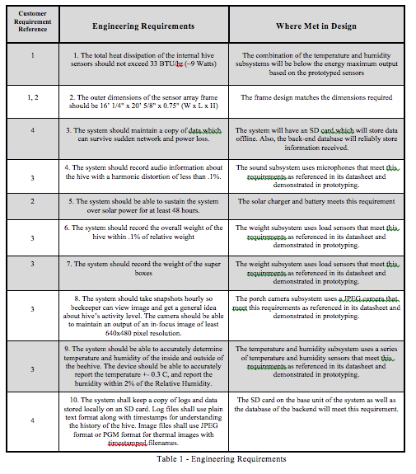
Example of Requirements and “Where Met”

Slide 5
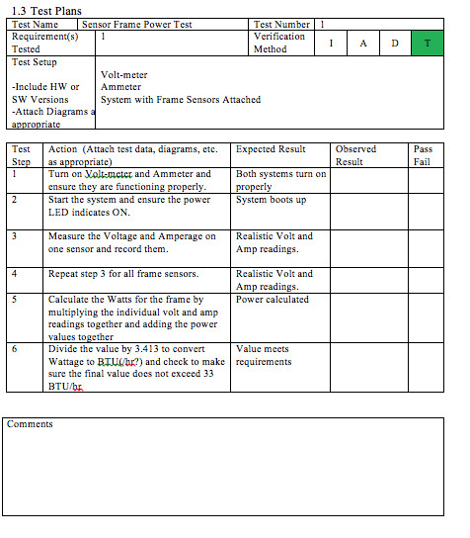
Beehive Test Case (Last Year)

Slide 6
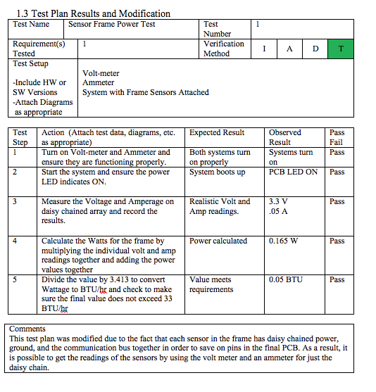
Beehive Test Case Completed

Slide 7
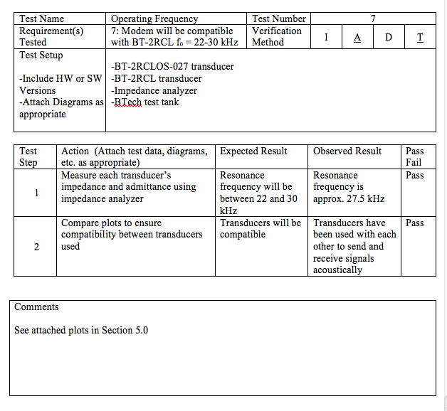
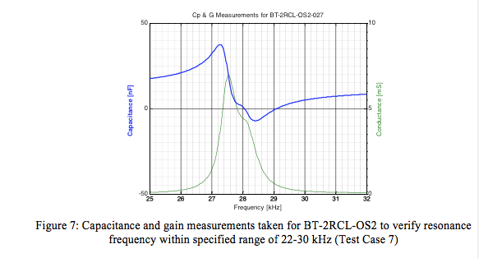
Acoustic Modem Test Case Completed With Data (Last Year)

Slide 8
Land Monitoring

Slide 9
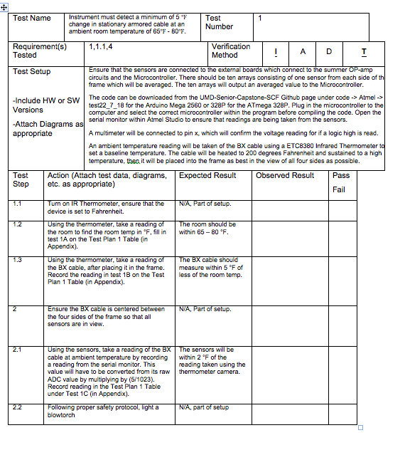
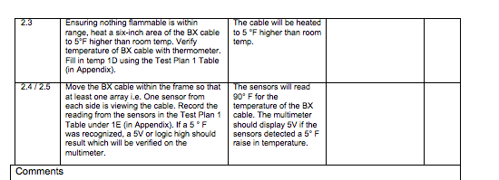
Cable Inspection

Slide 10
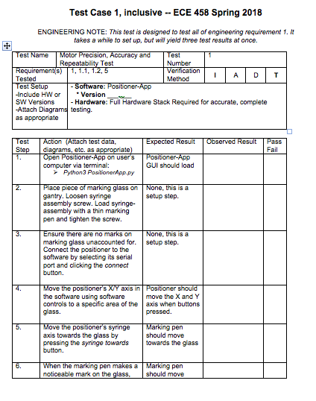
Precision Positioner

Slide 11
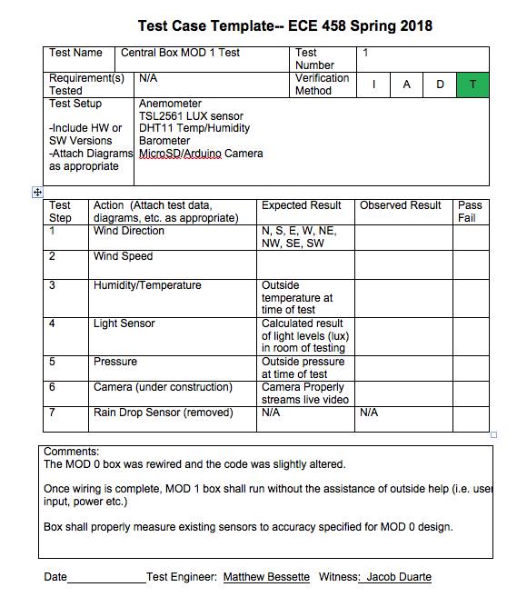
Beehive Monitoring

Slide 12
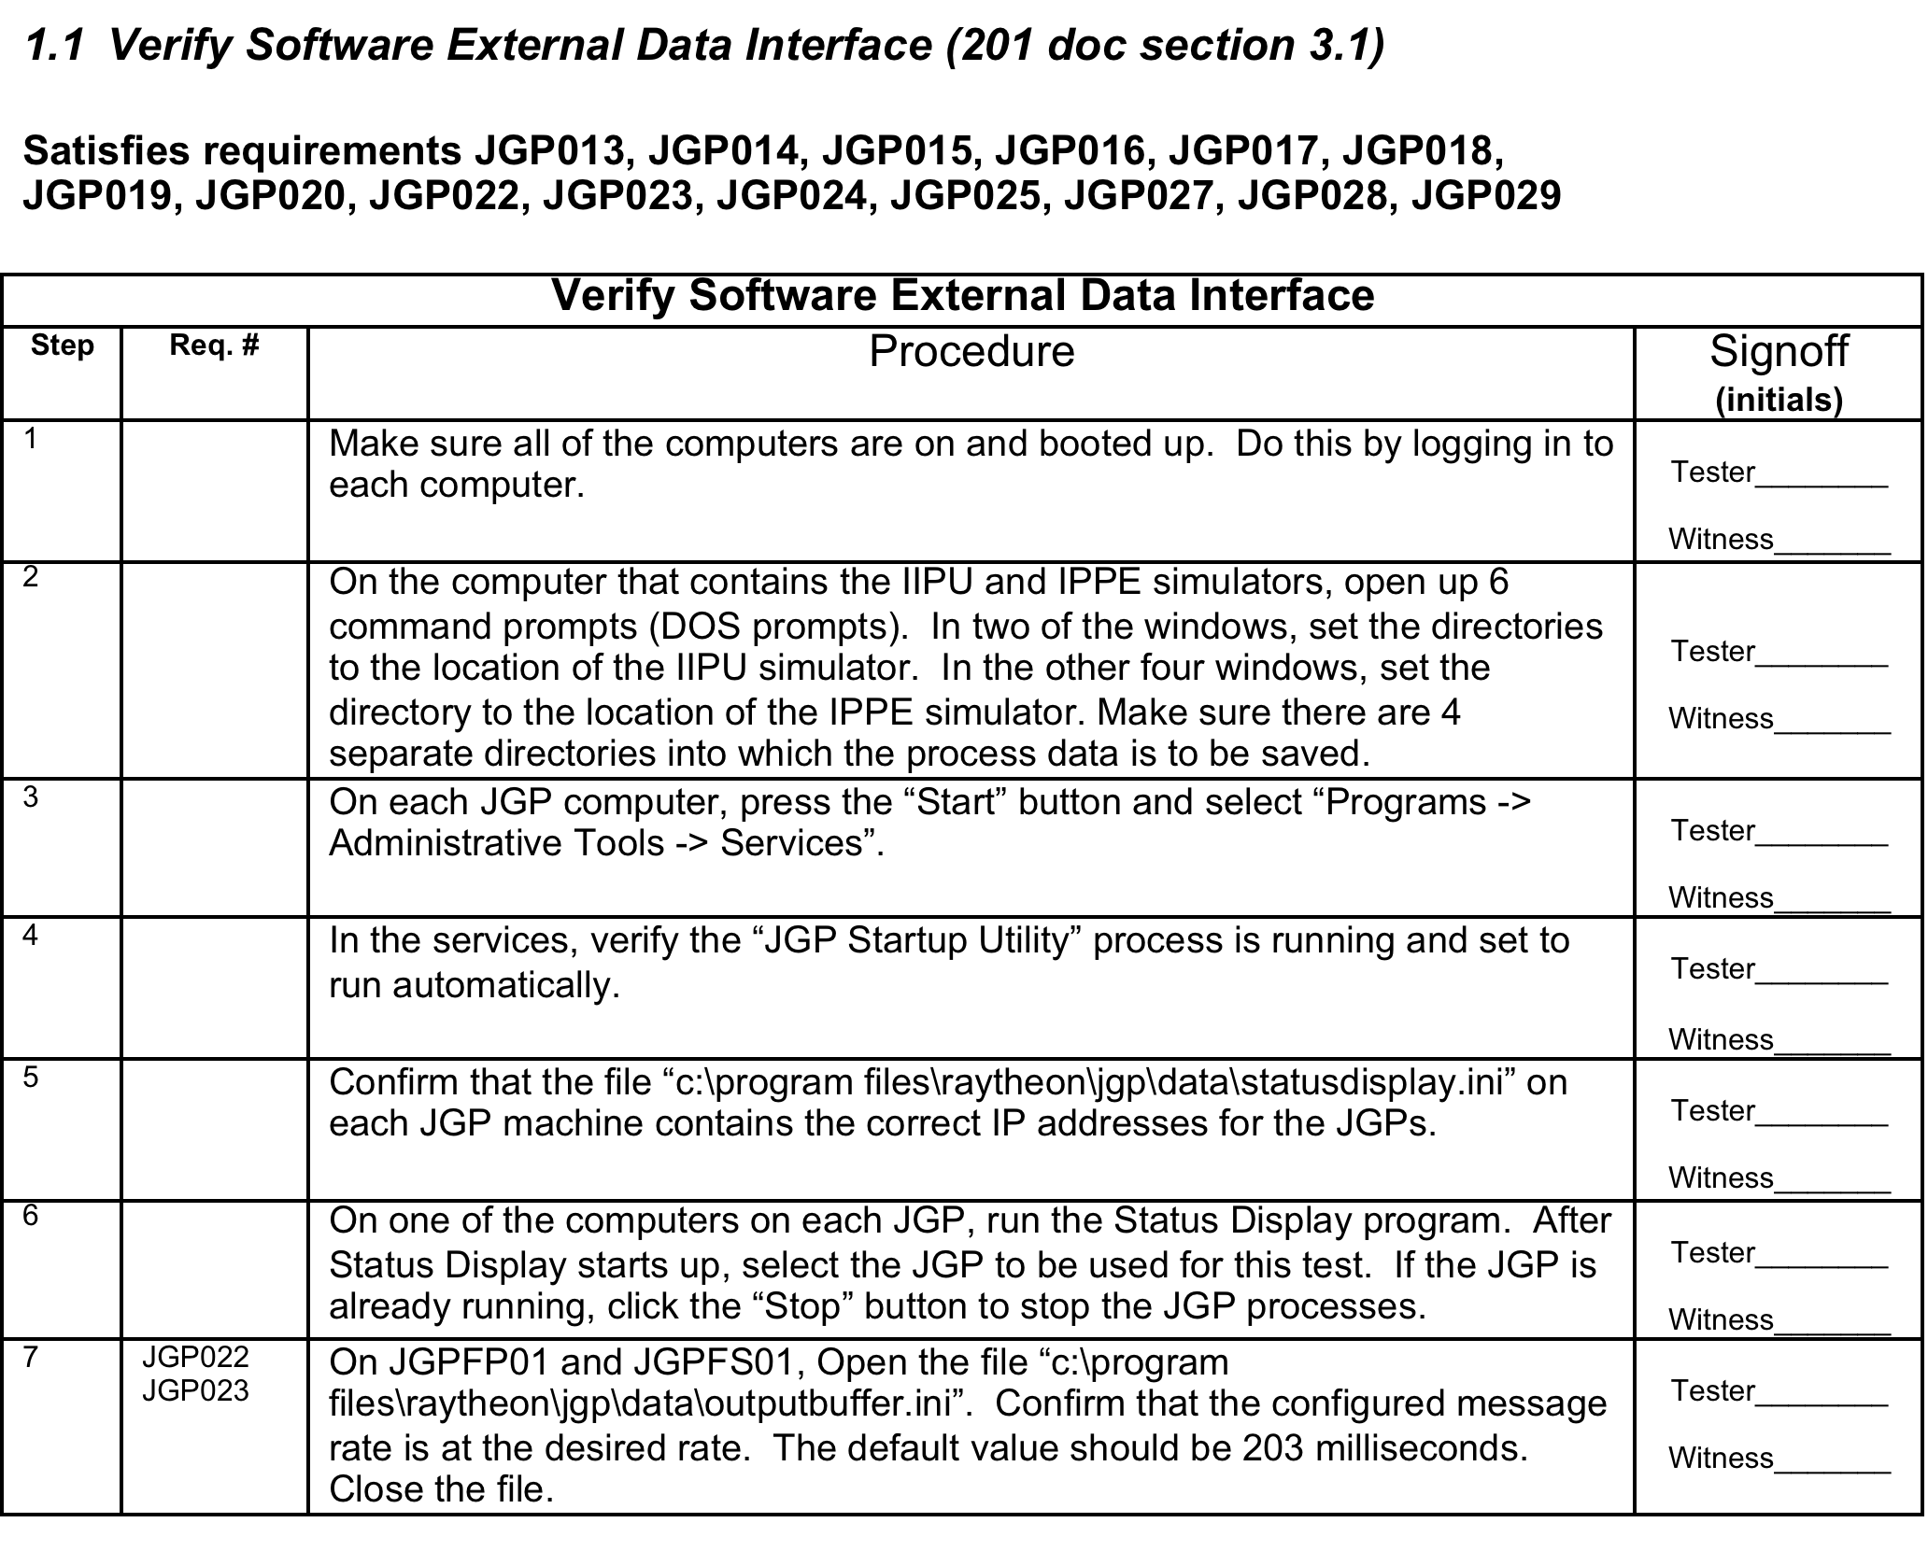
Example of Test Procedure-1

Slide 13
Example of Test Procedure-2

Slide 14
Example of Test Procedure-3

